Slide 1
Health Care System
By-Khushbu Parekh

Slide 2
Problem Statement
To Assure the safety of the patients by continuously monitoring their vital Signs with the help of the sensor embedded on the patients body.

Slide 3
Solution:
Create a system where in the patients who require continuous observation are given physical sensors and in case of any abnormality recorded the ambulance is dispatched and the doctor who has kept the patient under observation is notified by mail. Also the patients vital signs are saved in a central repository so any doctor view the records of the patient. Also in case of excess of blood loss the blood bank gets a notification to dispatch the to the doctor till the ambulance gets the patient.

Slide 4
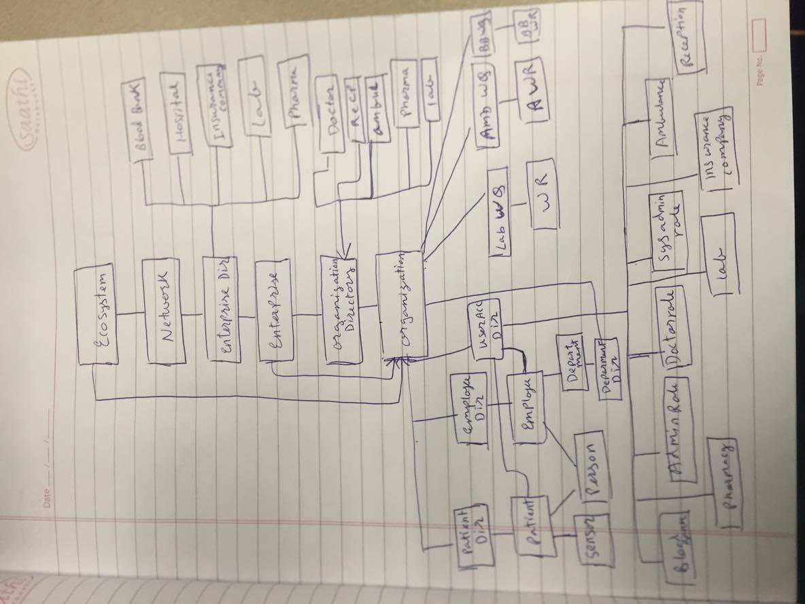
Object Model

Slide 5
Key Roles
Blood Bank- supplies blood in case of emergency.
Doctor- checks patients Vital Signs, prescribes medicines.
Receptionist – Books appointment with the patient.
Pharmacy- Delivers Medicine.
Insurance company- Maintains the insurance of the patient.
Lab- performs tests prescribed by the doctor.
Sensor- Continuously monitor vital Signs.
Ambulance-dispatches when notified by sensor or the patient.

Slide 6
Key Features
The Ambulance is notified and is dispatched when the patient’s vital signs show abnormal
The blood bank is notified when the blood count of the patient goes below the threshold.
Ordering medicine and booking appointments made esier.

Slide 7
Extra Features
Every Time the sensor find out the abnormality in the patients vital sign a mail notification is sent to the doctor
All the cost is managed by the insurance company and the patient will get a mail notification there is less balance available and the patient can then renew it from his end .
Inspired by: http://youtu.be/sICZ5mCKOOo

Slide 8
Thank You

